Slide 1
ME759 High Performance Computing for Applications in Engineering [Spring 2021]
Lecture 04
02/01/2021
Dan Negrut, 2021 ME759 UW-Madison

Slide 2
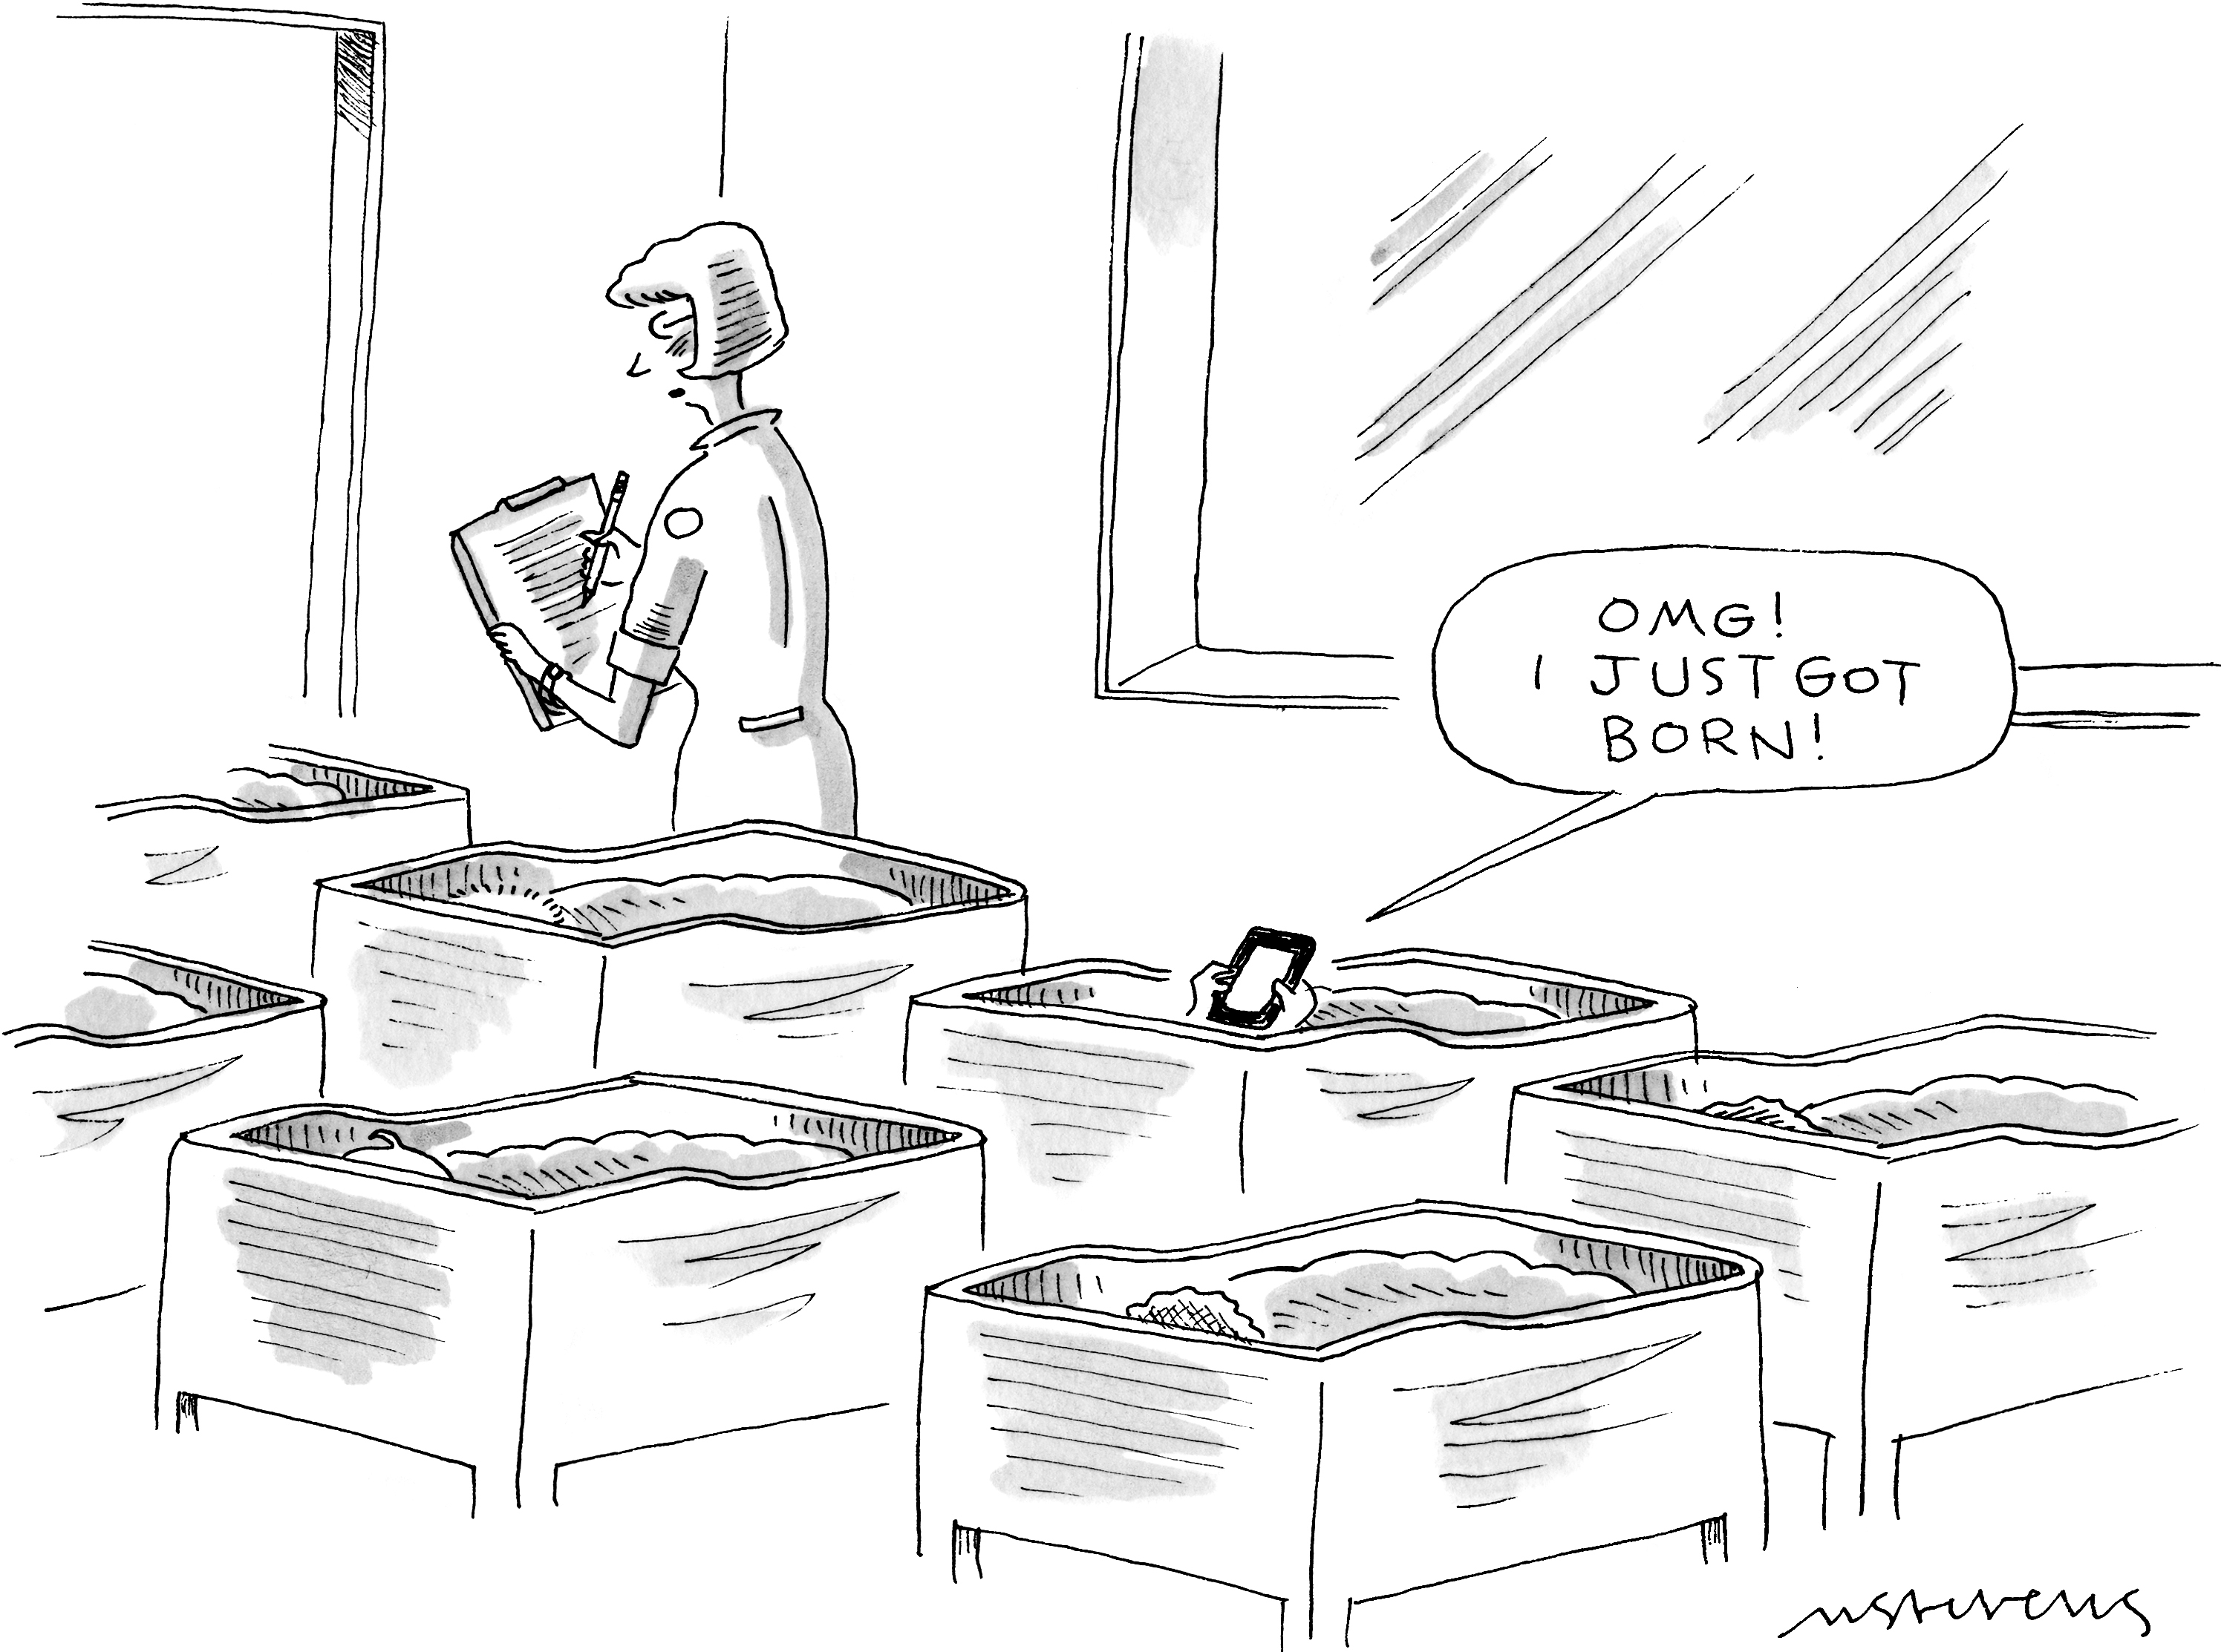
Cartoon of the day
[Mick Stevens]$→$

Slide 3
Quote of the day
“Success is the ability to go from failure to failure without loss of enthusiasm.” (Anonymous, but attributed to Lincoln, Churchill, etc. See here for more details.)

Slide 4
Is BBC recording on?
If my internet connection goes down, I’ll email from my phone to provide more information – go/no-go, next step, etc.

Slide 5
Before we get started…
Last time
Registers
ILP (focus on pipelining)
TLP, and HTT discussion
Today
Execution times
Memory related issues
The memory hierarchy
Caches
NOTE: we’ll draw on a couple of C programs; please read ME459 C material if the programs look alien
Other tidbits:
Assignment due on Th 02/04, at 9 pm
Please be mindful of how to use Euler (see doc that emailed on Sat night)
Please register for an Euler account (details provided in email of Th night)

Slide 6
Measuring Speed of Execution

Slide 7
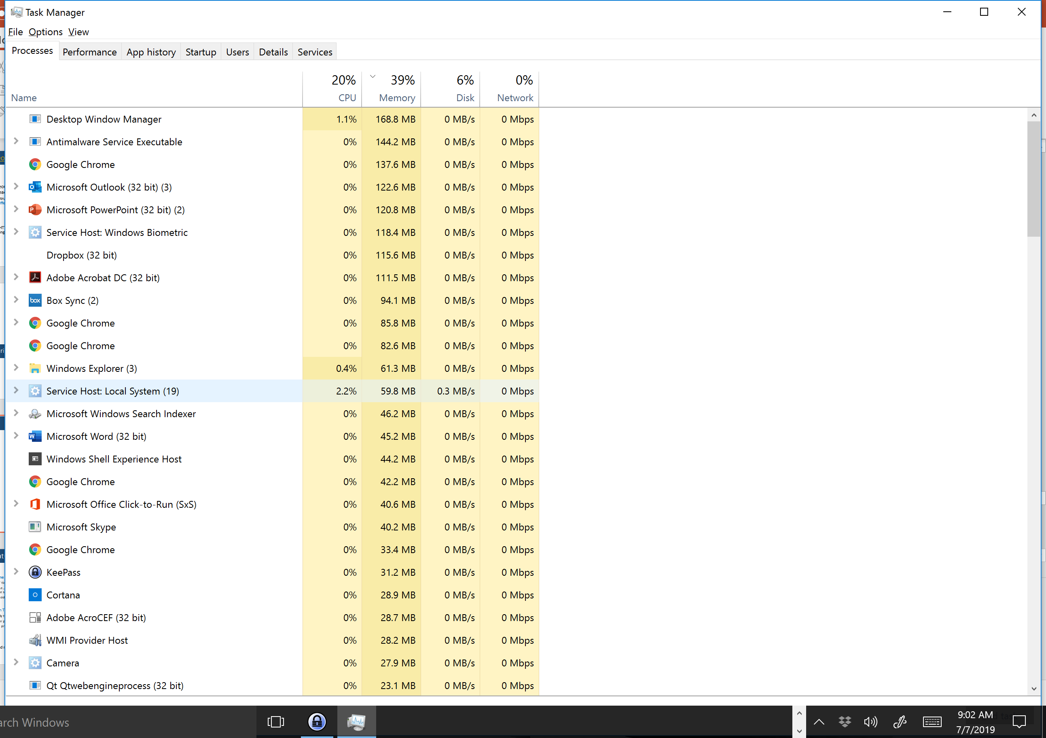
Backdrop: CPU/OS juggle many programs at the same time
The hardware-software interplay:
CPU is hardware
The operating system (OS) is software

Slide 8
Nomenclature (1/3)
Wall Clock Time
Amount of time from the beginning of a program to the end of the program
Includes; i.e., factors in, all the housekeeping (running other programs, OS tasks, etc.) that CPU does while running our program
Perhaps most meaningful indicator of performance since this is what you see
CPU Execution Time
Counts only the amount of time that is effectively dedicated to *your* program
Many other programs running on your machine at the same time (time slicing)
Requires a profiling tool to assess (like gprof, for instance)
On a dedicated machine; i.e., a quiet machine, Wall Clock Time and CPU Execution Time should be identical
[Patterson, 4th edition]→
Notes:
In general: Program Execution Time is what you care about (end-to-end time to solution)

Slide 9
Nomenclature (2/3)
Qualifying CPU Execution Time further:
User time – the time spent processing instructions compiled out of code generated by the user or in libraries that are directly called by user code
System time – time spent in support of the user’s program but in instructions that were not generated out of code written by the user
OS support: open file for writing/reading, throw an exception, etc.
The line between the user time and system time is somewhat blurred, sometimes hard to delineate and differentiate
“system vs. user”: We bother to delineate since we can only cut into the “user time”; you can’t rewrite system code

Slide 10
Nomenclature (3/3)
Clock cycle, cycle, tick – the length of the period for the processor clock
Clock cycle: sets the pace at which the execution proceeds
In a pipeline process, in a perfect scenario, each clock cycle sees the completion of one instruction
A constant value dictated by the frequency at which processor operates
Examples:
A 1 GHz processor has clock cycle of 1 nanosecond
A 2 GHz processor has clock cycle of 0.5 nanoseconds (500 picoseconds)
This machine I’m using right now: 3.8 GHz (AMD Ryzen 3900) – about 250 picosecond clock cycle

Slide 11

The CPU Performance Equation
Three ingredients control the amount of time for execution of a program:
Number of instructions that your program has (Instruction Count)
Average number of “clock-cycles per instructions” (CPI)
Clock Cycle Time
The CPU Performance Equation reads:
Alternatively, using the clock rate
$CPU Execution Time=Instruction Count ×CPI ×Clock Cycle Time$
$$CPU Execution Time= \frac{Instruction Count ×CPI}{Clock Rate}$$
[Patterson, 4th edition]→

Slide 12
CPU Performance: How can we improve it?
$CPU Execution Time=Instruction Count ×CPI ×Clock Cycle Time$
To improve performance the product of three factors should be reduced
For a long time, we’ve piggy backed on “let’s increase the frequency”; i.e., reduce Clock Cycle Time
We eventually hit a wall this way (the “Power Wall”)
As repeatedly demonstrated in practice, reducing the Instruction Count (IC) often times leads to an increase in CPI. And the other way around.
Notes:
Power Wall relationship: power dissipation is proportional to frequency
RISC: large IC, small CPI
CISC: small IC, large CPI
Tweaking CPI – the goal of ILP (but that seems to have exhausted its capabilities: “ILP wall”)
Parallel computing: do more of this in parallel

Slide 13
Side Trip: Revisiting, RISC or CISC?
Ongoing argument – whether RISC or CISC is the better ISA
The former is simple and therefore can be optimized easily. Yet it requires a large number of instructions to accomplish something in your C code
High IC but low CPI
The latter is complex, but instructions are expressive. Leads to few but expensive instructions to accomplish something in your C code
Low IC but high CPI
Specific example: ARM vs. x86

Slide 14
SPEC CPU Benchmarks
Benchmarks help us understand what processor does well what
Idea: gather a collection of programs that use a good mix of instructions and flex the muscles of a chip
The “collection of programs”:
Should be non-trivial and widely used
Should be as objective as possible: not favor a chip manufacturer at the expense of another one
Example: a compiler is used extensively, so it makes sense to have it included in the benchmark
Two common benchmarks:
Tied to programs dominated by floating point operations: CFP2006
Tied to programs dominated by integer arithmetic: CINT2006
Notes:
SPEC: Standard Performance Evaluation Corporation (non-profit)
Different processors are better at different things.

Slide 15
SPEC CPU Benchmark: Example, highlights AMD performance
CINT2006 Programs |  | AMD Opteron X4 – 2356 (Barcelona)
Description | Name | Instruction count [×10⁹] | CPI | Clock Cycle Time [seconds ×10⁻⁹] | CPU Exec. Time [seconds]
Interpreted string processing | perl | 2118 | 0.75 | 0.4 | 637
Block-sorting compression | bzip2 | 2389 | 0.85 | 0.4 | 817
GNU C compiler | gcc | 1050 | 1.72 | 0.4 | 724
Combinational optimization | mcf | 336 | 10.00 | 0.4 | 1,345
Go game (AI) | go | 1658 | 1.09 | 0.4 | 721
Search gene sequence | hmmer | 2783 | 0.80 | 0.4 | 890
Chess game (AI) | sjeng | 2176 | 0.96 | 0.4 | 837
Quantum computer simulation | libquantum | 1623 | 1.61 | 0.4 | 1,047
Video compression | h264avc | 3102 | 0.80 | 0.4 | 993
Discrete event simulation library | omnitpp | 587 | 2.94 | 0.4 | 690
Games/path finding | aster | 1082 | 1.79 | 0.4 | 773
XML parsing | xatancbmk | 1058 | 2.70 | 0.4 | 1,143
[Patterson, 4th edition]→

Slide 16
SPEC CPU Benchmark: Example, wrap up
There are programs for which the CPI is less than 1.
Suggests that multiple issue is at play
Why are there programs with CPI of 10?
The pipeline stalls a lot, most likely due to repeated cache misses and system memory transactions
[Patterson, 4th edition]→
Notes:
Program with CPI=10 : combinatorics, likely many memory accesses “all over the place”. This segues in the next segment, where we will discuss memory-related issues.

Slide 17

Important, common sense observation
You get the brownie points for writing code whose instructions fly through the chip
Nobody particularly impressed by instructions that take a long time to execute

Slide 18
Big New Topic: Memory Aspects

Slide 19
Transistors: why we love them & want as many as possible_{[old slide]}
Focus first on how transistors are used to perform tasks (tied to CU and ALU use)
Later talk about how transistors are used to store data and instructions
Memory Data
Instructions
Data
Memory
Processor
(Chip)
instructions flow
Control Unit (CU)
Arithmetic Logic Unit (ALU)
data flow
internal consumption (uops?)
internal consumption data

Slide 20
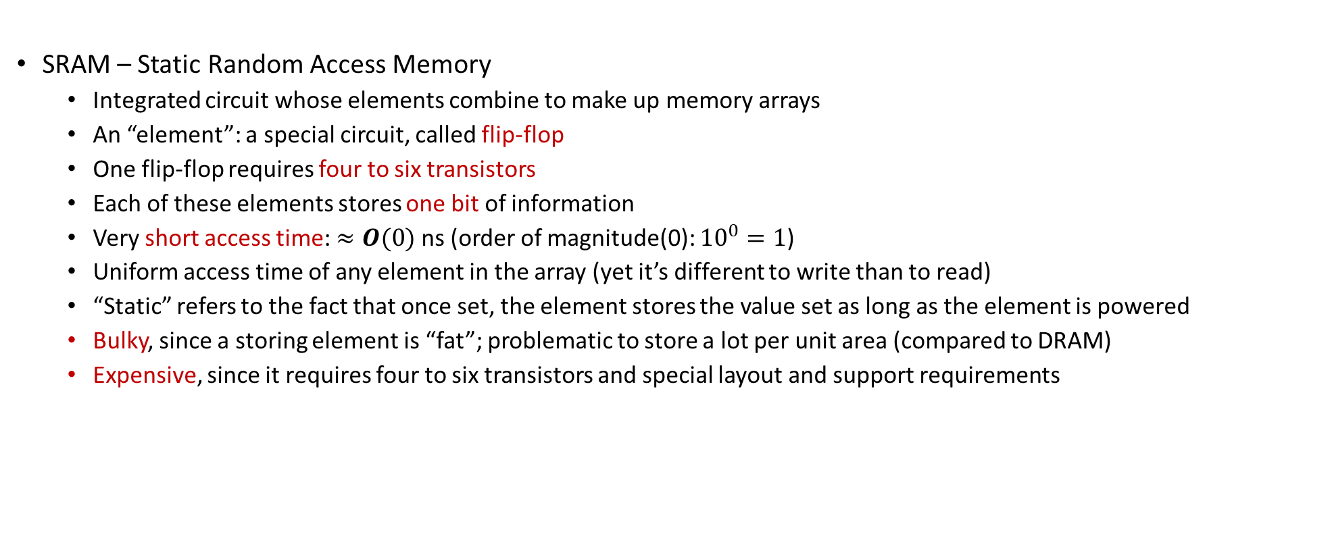
SRAM: significant consumer of transistors
SRAM – Static Random Access Memory
Integrated circuit whose elements combine to make up memory arrays
An “element”: a special circuit, called flip-flop
One flip-flop requires four to six transistors
Each of these elements stores one bit of information
Very short access time: $≈O(0)$ ns (order of magnitude(0): ${10}^{0}=1$)
Uniform access time of any element in the array (yet it’s different to write than to read)
“Static” refers to the fact that once set, the element stores the value set as long as the element is powered
Bulky, since a storing element is “fat”; problematic to store a lot per unit area (compared to DRAM)
Expensive, since it requires four to six transistors and special layout and support requirements
[Patterson & H]→
Notes:
SRAM is an integrated circuit whose elements combine to make up memory arrays.
In figure: the memory chip can store 4 million 32 bit data.
For 4 million addresses: 2^22, you need address lines.
Data in/out: 8 + 8
Additionally, need 3 control lines (Chip select, Write enable, Output enable)

Slide 21
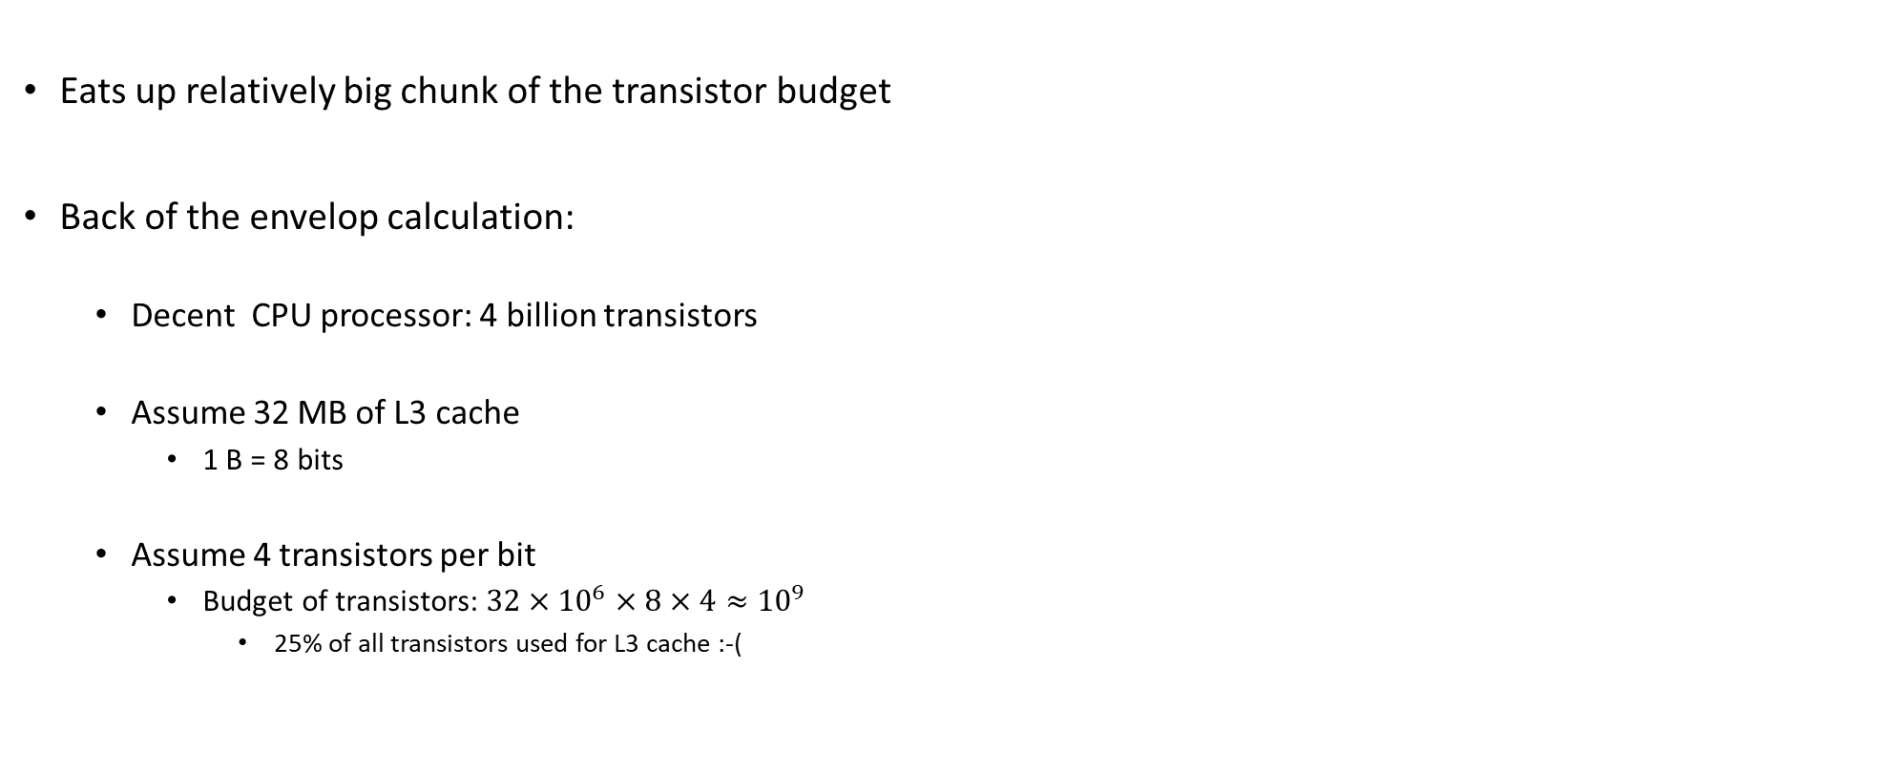
SRAM: It’s Expensive
Eats up relatively big chunk of the transistor budget
Back of the envelop calculation:
Decent CPU processor: 4 billion transistors
Assume 32 MB of L3 cache
1 B = 8 bits
Assume 4 transistors per bit
Budget of transistors: $32×{10}^{6}×8×4≈{10}^{9}$
25% of all transistors used for L3 cache :-(

Slide 22
DRAM
DRAM type memory: the information stored as a charge in a capacitor
No charge: 0 signal
Some charge: 1 signal
The good: cheap, requires only one capacitor and one transistor
The bad: capacitors leak, so the charge or lack of charge should be reinforced every so often, dynamically
D in DRAM comes for the “dynamically” attribute
Moral of the story: State of the capacitor should be refreshed every millisecond or so
Refreshing requires a small delay in memory accesses
Is this delay incurred often? (first order approximation answer)
Given frequency at which memory is accessed, refreshing every millisecond means issues might appear once every million cycles
Moral of the story: refresh is a rare event (in the life of the execution cycle)
[Patterson & H]→

Slide 23
SRAM vs. DRAM: wrap-up
SRAM access time: of the order of nanoseconds or tens of nanoseconds
Expensive but fast
Transistor hog
Needs no refresh
DRAM access time: of the order of hundreds of nanoseconds
Less expensive but slow
Higher capacity per unit area
Needs refresh every 10-100 ms
Sensitive to disturbances
Limit case: a 100X speedup if you can work off the SRAM
 | Transistors per bit | Access Time | Persistent? | Sensitive? | Price | Applications
SRAM | 6 | 1X | Yes | No | 100X | Cache memories
DRAM | 1 | 100X | No | Yes | 1X | Main Memory
[Rauber&Runger]→
Notes:
[Rauber&Runger]→ Typical access times are 0.5–2.5 ns (ns = nanoseconds = 10−9 seconds) compared to 50–70 ns for DRAM (values from 2008 [84])
From Rochester (http://www.cs.rochester.edu/~sandhya/csc252/lectures/lecture-storage.pdf):
Key features
– RAM is packaged as a chip.
– Basic storage unit is a cell (one bit per cell).
– Multiple RAM chips form a memory.
• Static RAM (SRAM)
– Each cell stores bit with a six-transistor circuit.
– Retains value indefinitely, as long as it is kept powered.
– Relatively insensitive to disturbances such as electrical noise.
– Faster and more expensive than DRAM.
• Dynamic RAM (DRAM)
– Each cell stores bit with a capacitor and transistor.
– Value must be refreshed every 10-100 ms.
– Sensitive to disturbances.
– Slower and cheaper than SRAM.

Slide 24
Feature Comparison Between Memory Types
 | SRAM | DRAM | Flash
Speed | Very fast | Fast | Very slow
Density | Low | High | Very high
Power | Low | High | Very low
Refresh | No | Yes | No
Retention | Volatile | Volatile | Non-volatile
Mechanism | Bi-stable Latch | Capacitor | Fowler-Nordheim tunneling
Notes:
Flash memory: Toshiba (1980)
Uses “floating-gate transistors”

Slide 25
New Topic: The Memory Hierarchy
Common Sense Observations
Observation 1: over time, speed of data processing increased faster than speed at which we could bring over data to be processed
Observation 2: the bigger the memory used to store data, the longer it takes to find/access an entry therein
Compromise between size and speed of access

Slide 26
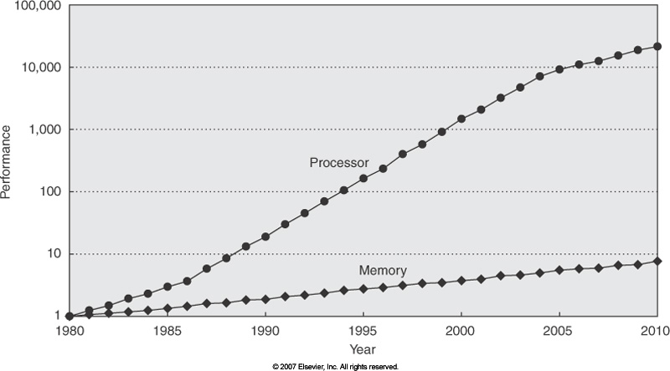
Backdrop: Widening of the Processor-DRAM Speed Gap
Courtesy of Elsevier, Computer Architecture, Hennessey and Patterson, fourth edition
Notes:
QUESTION: we talk about memory wall as an impediment to continuing increase in sequential computing performance and we said that the problem is that memory cannot keep up feeding the raw number crunching capability of the CPU.
But then, how can parallel computing be the answer? How could memory serve now multiple “consumers” and yet overall performance increase?
To explain this, we note that memory performance is related to two key concepts:
latency
bandwidth

Slide 27
Consequences of common sense observations
Consequences of Observations 1 & 2: a hierarchy of memories has emerged
It took some time to shape up, happened through a continuous improvement process
Managing the hierarchy not trivial → a dedicated hardware asset called MMU (memory management unit) handling this task
MMU’s purview: cache control, virtual memory management, memory protection, bus arbitration, etc.

Slide 28
The memory hierarchy, how it shapes up
Since SRAM is expensive and bulkier, can’t have too much
Plagued by space & cost constraints
Compromise:
Have some SRAM on-chip, making up what is called the “cache”
Have a lot of inexpensive DRAM off-chip, making up the “main memory”
This is what people have in mind when they ask you “How much memory does your system have”?
In our code, we hope to have low “average memory access time” by hitting the cache repeatedly instead of taking costly trips to main memory
Notes:
A single issue pipelined processor that operates at 2 GHz could in theory execute one instruction every 0.5 nanoseconds. SRAM has access times in that range; DRAM memory has access times about 50 times slower. In an ideal world, one would have all data available in SRAM so that the processor can work at capacity. Since SRAM is expensive and bulky only a small amount is available in the processor to store both data and instructions. This small amount of memory is called cache memory.

Slide 29
There’s even a cache hierarchy…
Simplest memory hierarchy:
Main Memory + One Cache (typically called L1 cache)
Today’s memory architectures typically have deeper hierarchy: L1+L2+L3
L1 faster and smaller than L2
L2 faster and smaller than L3
All caches are typically on the chip and are SRAM
Notes:
L1 also uses “better components” than L2

Slide 30
Typical Memory Hierarchy
[Bryant and O‘Hallaron: Computer Systems - A Programmer's Perspective 3rd edition] →
L0:
Regs
CPU registers hold words retrieved from the L1 cache.
Smaller,
faster,
and
costlier
(per byte)
storage
devices
L1:
L1 cache
(SRAM)
L1 cache holds cache lines retrieved from the L2 cache.
L2:
L2 cache
(SRAM)
L2 cache holds cache lines
retrieved from L3 cache
L3:
L3 cache
(SRAM)
L3 cache holds cache lines
retrieved from main memory.
Larger,
slower,
and
cheaper
(per byte)
storage
devices
L4:
Main memory
(DRAM)
Main memory holds disk blocks retrieved from local disks.
L5:
Local secondary storage
(local disks)
Local disks hold files retrieved from disks
on remote servers
L6:
Remote secondary storage
(e.g. file servers)

Slide 31
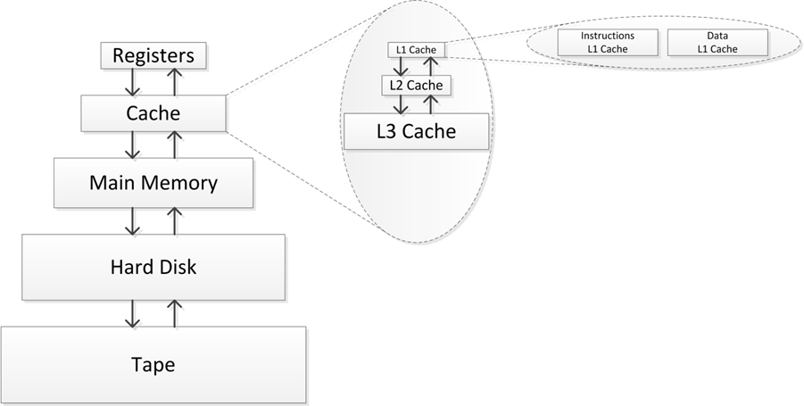
Memory Hierarchy
The collection of all registers is called “the register file”
Moving on to talk about caches

Slide 32
Cache Memories
Cache memories are small, fast, on-chip SRAM-based memories
Purpose: to store close to the CU/ALU frequently accessed blocks of main (aka “system”) memory
Schematic of chip’s datapath (chip=datapath + CU), and where the cache fits in the big pic:
CPU chip
Register file
ALU
Cache
memory
System bus
Memory bus
Main
memory
Bus interface
I/O
bridge
[Bryant and O‘Hallaron: CMU] →

Slide 33
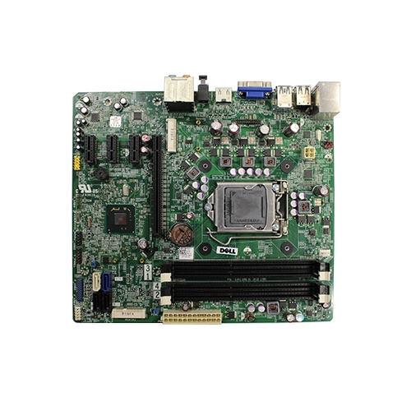

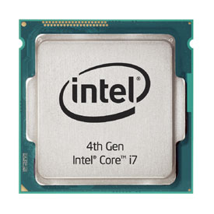
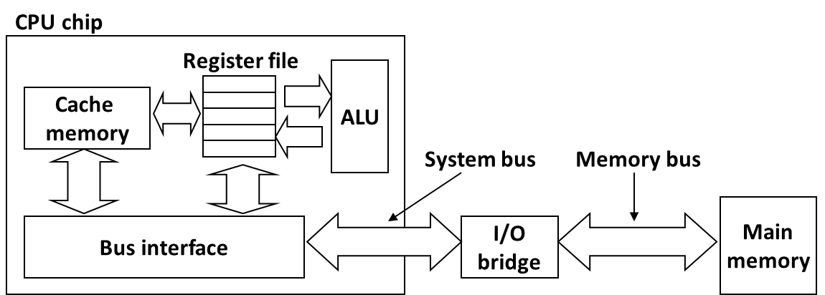
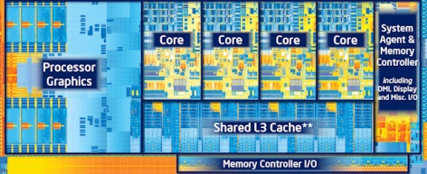
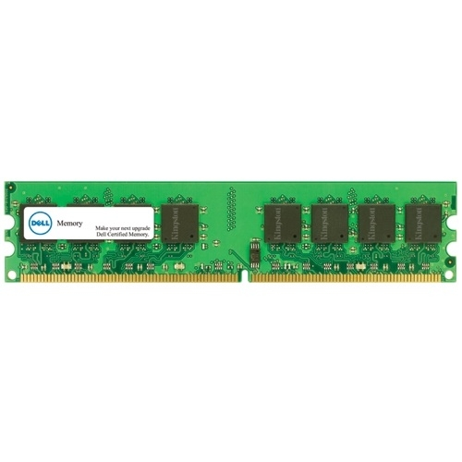
What it really looks like…
Motherboard
Source: Dell
Desktop PC
CPU (Intel Core i7)
Gets dropped in here
Source: PC Magazine
Source: Dell
Main memory (DRAM)
Source: techreport.com
Source: Dell
[Bryant and O‘Hallaron: CMU] →

Slide 34
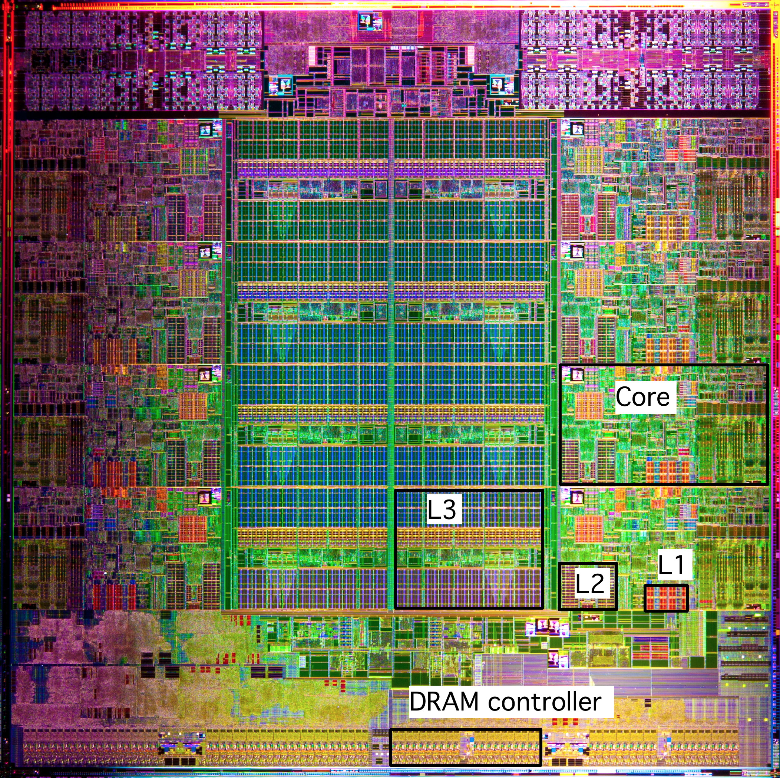
What it Really Looks Like [contd.]
Intel Sandy Bridge-E
Processor Die
[8 core-version]
CPU chip (CU not shown below)
Register file
ALU
Cache
memory
Bus interface
L3
L1: 32KB Instruction + 32KB Data
L2: 256KB
L3: 5–20MB
[Bryant and O‘Hallaron: CMU] →

Slide 35
Caches: Come In Two Flavors
Data caches feed processor with data manipulated during execution
If processor would rely on data provided by main memory the execution would be pitifully slow
“Processor Clock” much faster than the “Memory Clock”
Caches alleviate the memory pressure – processors are data hungry
Instruction caches: used to store instructions
Simpler to deal with compared to the data caches
By and large, instruction use is much more predictable than data use

Slide 36
How Cache Comes into Play
All* read/write operations go through cache
Caches used to hold both data and instructions
Data and instructions caches are in general different
Intel: L1 DC (data cache) and L1 IC (instruction cache) have been distinct since approximately 1993
CPU Core
Cache
Bus
Main Memory

Slide 37
Multiple Levels of Cache
Commodity chips today have 3 cache levels
(some chips have a fourth cache level, see previous slide)
CPU Core
L1 D$
L1 I$
L2 Cache
L3 Cache
Bus
Main Memory

Slide 38
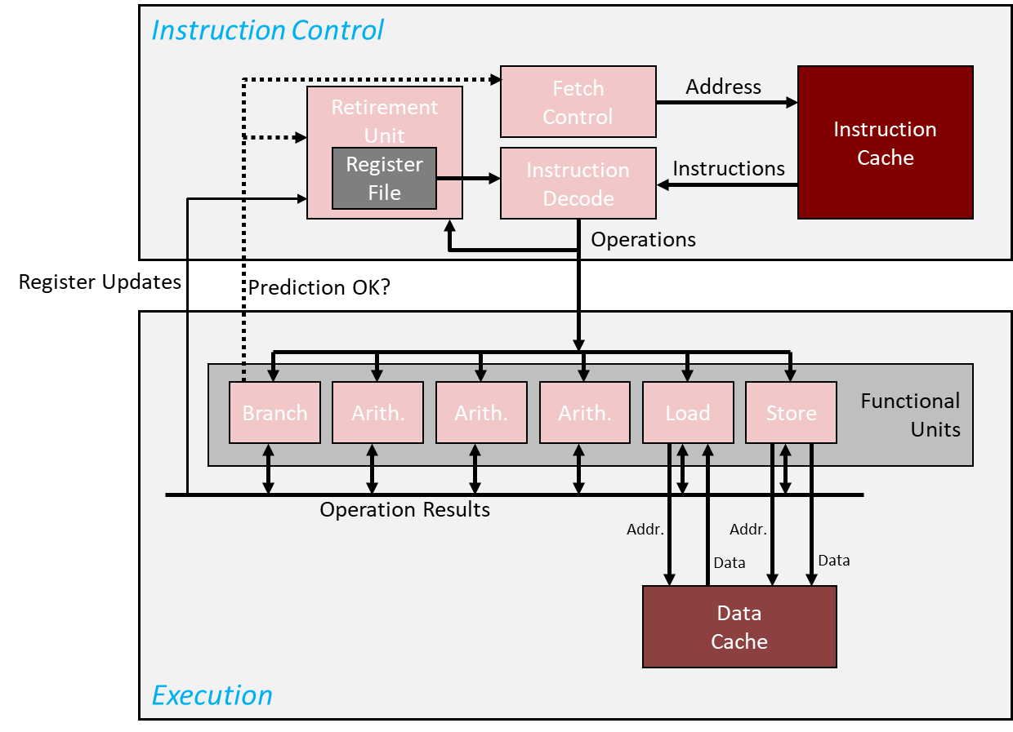
Processor Clock vs. Memory Clock [important to understand]
From RAM
Processor Clock: (look for the box )
Dictates/defines the frequency at which Functional Units operate
Memory Clock:
Dictates/defines the frequency used to move data into/out from main memory into cache
To/From RAM

Slide 39
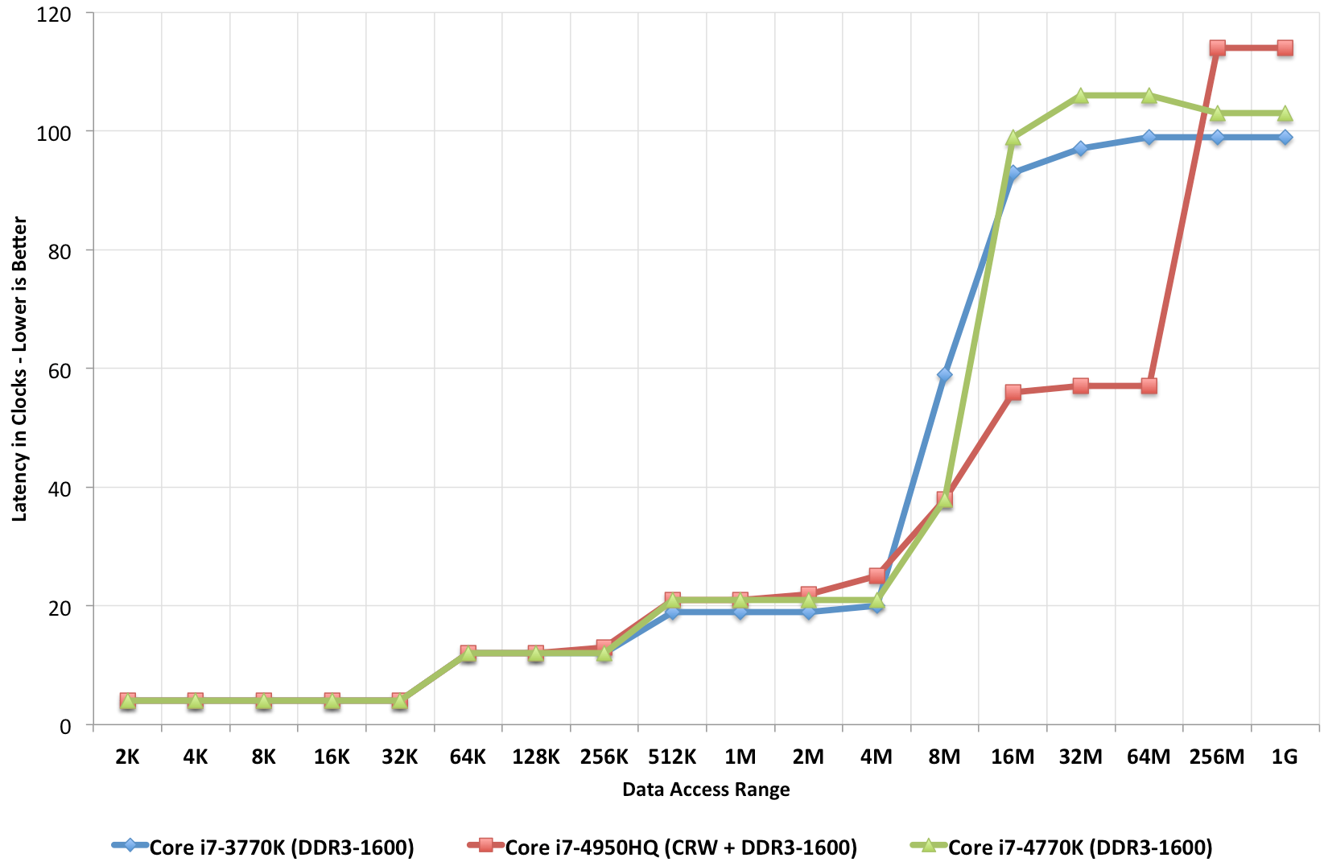
Caches: How large? Also, how fast?
Ratio between cache size and main memory size
Reasonable to expect something like 1:1000
2013: 4 MB of L3 cache, versus 4 GB of main memory
2017: 55 MB of L3 cache, versus 64 GB of main memory
This is the overhead of a system memory access (about 100+ cycles)
Vintage: 2013 (related to Intel’s Haswell)
Latency in Clocks –Lower is Better
This chip has L4 cache, read more about it here
(log scale)

Slide 40
Intel Core i7 Cache Hierarchy
Processor package
Core 0
Core 7
Regs
Regs
L1 i-cache and d-cache:
32 KB, 8-way assoc.
Access: 4 cycles
L2 unified cache:
256 KB, 8-way assoc.
Access: 10 cycles
L3 unified cache:
8 MB, 16-way assoc.
Access: 40-75 cycles
Cache line size: 64 bytes for all caches.
L1
d-cache
L1
i-cache
L1
d-cache
L1
i-cache
…
L2 unified cache
L2 unified cache
L3 unified cache
(shared by all cores)
Main memory
[Bryant and O‘Hallaron: Computer Systems - A Programmer's Perspective 3rd edition] →

Slide 41
We talked about the hardware side of things, for caches
Let’s talk about the software side of things, to see how caches come into play

Slide 42
Why Caches Work: the “Principle of Locality”
Principle of Locality: Programs tend to use data and instructions with addresses near or equal to those they have used recently
Temporal locality:
“Recently referenced items are likely to be referenced again in the near future”
Spatial locality:
“Items with nearby addresses tend to come into use together”
[Bryant and O‘Hallaron: Computer Systems - A Programmer's Perspective 3rd edition] →

Slide 43
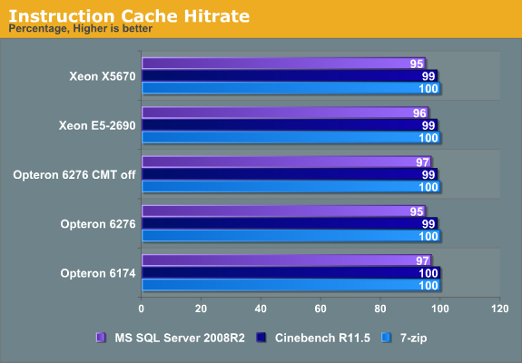
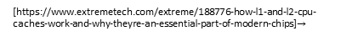
Typical hit rates, actual numbers vary based on application
Instruction cache hit rate
[https://www.extremetech.com/extreme/188776-how-l1-and-l2-cpu-caches-work-and-why-theyre-an-essential-part-of-modern-chips]$→$

Slide 44
Spatial and Temporal Locality
Temporal Locality for memory access by a program
Idea: If you access a variable at some time, then you’ll probably keep accessing the same variable for a while
Example: a for loop with some variables inside the loop → you keep accessing those variables as long as you loop
Spatial Locality for memory access by a program
A memory access pattern characterized by bursts of repeated requests for data that is physically located within the same memory region
“Bursts” because these accesses should happen in a sufficiently short interval of time (lest the cache line gets evicted)

Slide 45
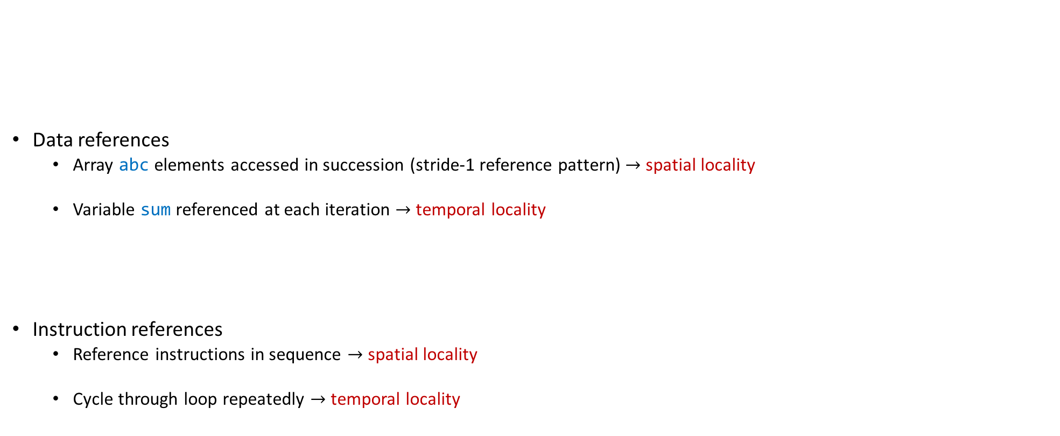
Example, regarding concept of “locality”
// some simple code snippet
sum = 0;
for (i = 0; i < n; i++)
sum += abc[i];
return sum;
Data references
Array abc elements accessed in succession (stride-1 reference pattern) $→$ spatial locality
Variable sum referenced at each iteration $→$ temporal locality
Instruction references
Reference instructions in sequence $→$ spatial locality
Cycle through loop repeatedly $→$ temporal locality
[Bryant and O‘Hallaron: Computer Systems - A Programmer's Perspective 3rd edition] →

Slide 46
Example: Adding the Entries in a 2D Matrix
Example used over several slides to show how “locality” and caches impact performance
Very related to your second assignment

Slide 47
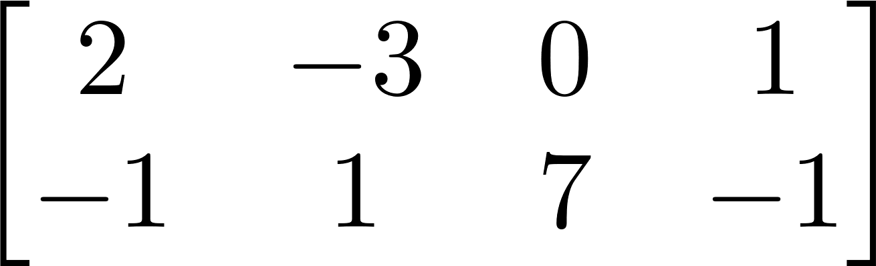
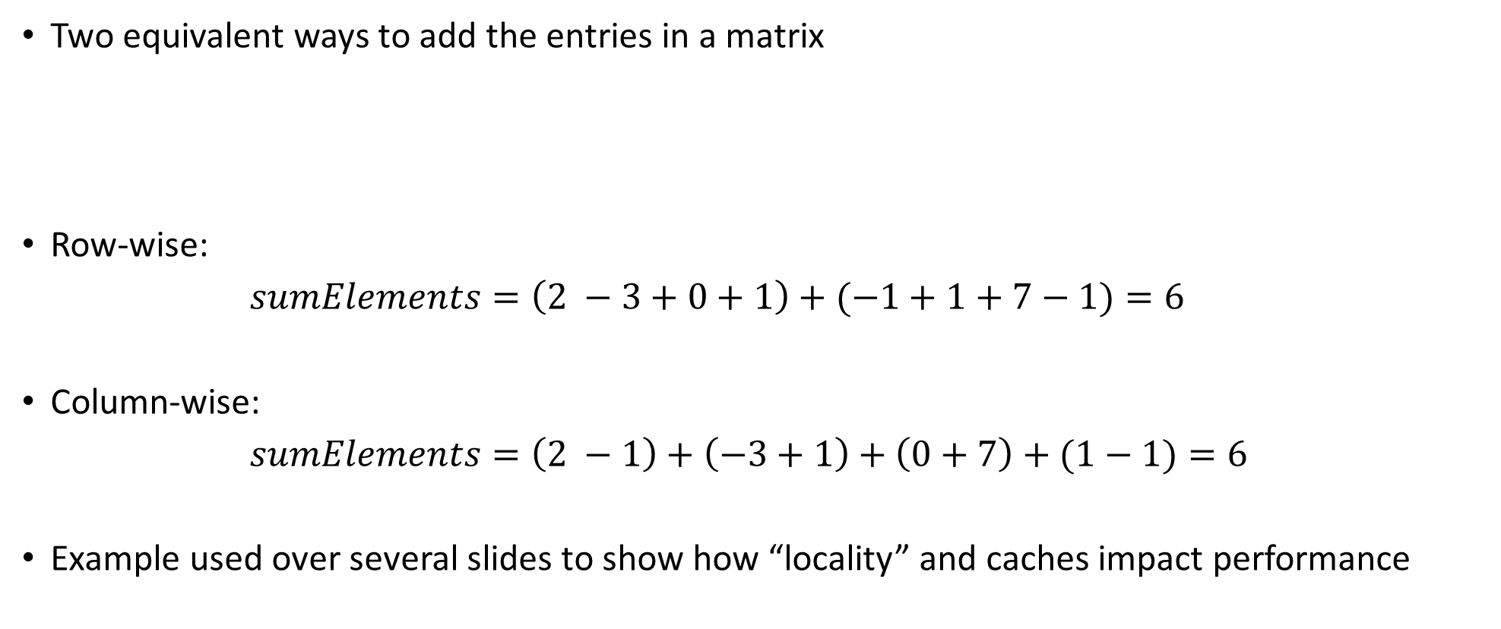
Example [motivation]: Adding the Entries in a 2D Matrix
Two equivalent ways to add the entries in a matrix
Row-wise:
$sumElements=\left(2 −3+0+1\right)+(−1+1+7−1)=6$
Column-wise:
$sumElements=\left(2 −1\right)+\left(−3+1\right)+\left(0+7\right)+(1−1)=6$
Example used over several slides to show how “locality” and caches impact performance
First row
Second row
First column
Second column
Third column
Fourth column

Slide 48
Squashed format vs. 2D format
Storing a matrix: squashed format OR 2D format
Example:
Squashed format – using one long contiguous array of 6 entries. Like in your homework
The 2D format – using two arrays:
Each has 4 entries
Each of the two arrays stored somewhere in the memory (they might be far from each other)

Slide 49
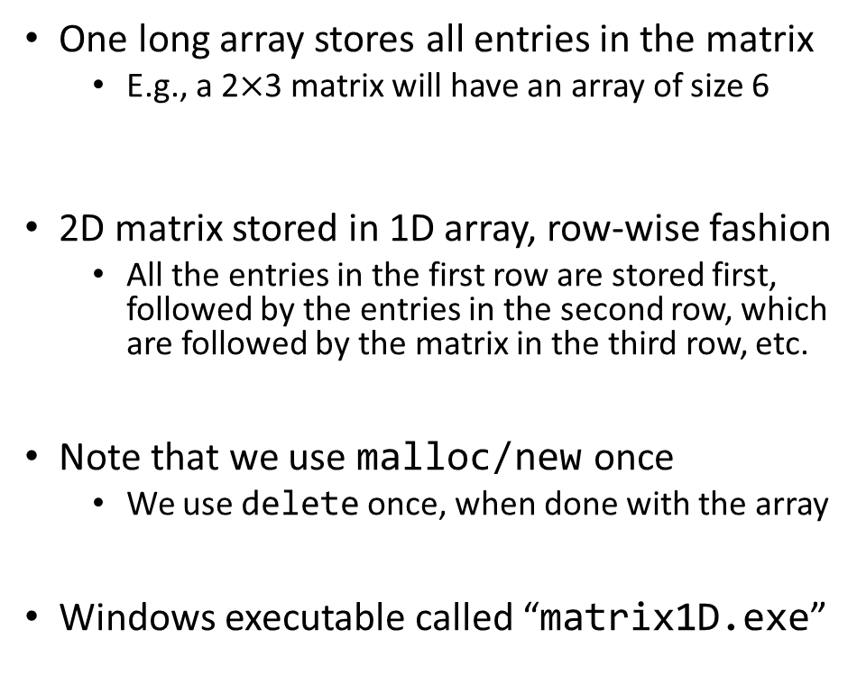
First way to represent 2D matrix: the “squashed,” 1D approach
#include <cstdio>
struct squashedMatrix {
/// 2D matrix stored row-wise in a one dimensional array
unsigned int height; /// number of rows in matrix
unsigned int width; /// number of columns in matrix
double *pMatVals;
};
int main() {
struct squashedMatrix mat1D;
mat1D.height = 1000; // perhaps you set this based on user input
mat1D.width = 2000; // perhaps you set this based on user input
mat1D.pMatVals = new double[mat1D.height * mat1D.width];
unsigned int i, j;
for (i = 0; i < mat1D.height; i++)
for (j = 0; j < mat1D.width; j++)
mat1D.pMatVals[i * mat1D.width + j] = 1. / (i + j + 1.);
// Compute sum of elements
double sum = 0.;
for (i = 0; i < mat1D.height; i++)
for (j = 0; j < mat1D.width; j++)
sum += mat1D.pMatVals[i * mat1D.width + j];
std::printf("The sum of the elements is: %f\n", sum);
// Done with the matrix; free the memory
delete[] mat1D.pMatVals;
return 0;
}
One long array stores all entries in the matrix
E.g., a 2$×$3 matrix will have an array of size 6
2D matrix stored in 1D array, row-wise fashion
All the entries in the first row are stored first, followed by the entries in the second row, which are followed by the matrix in the third row, etc.
Note that we use malloc/new once
We use delete once, when done with the array
Windows executable called “matrix1D.exe”

Slide 50
A second way to represent the 2D matrix: the 2D approach
#include <cstdio>
struct Matrix2D {
/// 2D matrix stored row-wise in a one dimensional array
unsigned int height; /// number of rows in matrix
unsigned int width; /// number of columns in matrix
double **pRows;
};
int main() {
struct Matrix2D mat2D;
mat2D.height = 1000; // perhaps you set this based on user input
mat2D.width = 2000; // perhaps you set this based on user input
mat2D.pRows = new double*[mat2D.height];
unsigned int i;
for (i = 0; i < mat2D.height; i++)
mat2D.pRows[i] = new double[mat2D.width];
// Get meaningful values in this matrix
unsigned int j;
for (i = 0; i < mat2D.height; i++)
for (j = 0; j < mat2D.width; j++)
mat2D.pRows[i][j] = 1. / (i + j + 1.);
// Compute sum of elements
double sum = 0;
for (i = 0; i < mat2D.height; i++)
for (j = 0; j < mat2D.width; j++)
sum += mat2D.pRows[i][j];
std::printf("The sum of the elements is: %f\n", sum);
// Don't data anymore, free mem; note that free is used twice
for (i = 0; i < mat2D.height; i++)
delete[] mat2D.pRows[i];
delete[] mat2D.pRows;
return 0;
}
First, we allocate room to store a bunch of pointers to double
There are “height” of these “double *” pointers
These pointers stored in the array pRows
For each matrix row (and there are “height” of them), we allocate enough room to store “width” doubles
These are the values that show up in a row of the matrix
Note that we use new/malloc multiple times
We’ll have to use delete multiple times
Windows executable called “matrix2D.exe”

Slide 51

The squashed approach, revisited: locality vs. non-locality
#include <chrono> // need this for cross-platform timers in C++
#include <cstdio>
#include <cstdlib>
struct squashedMatrix {
/// 2D matrix stored row-wise in a one dimensional array
unsigned int height; /// number of rows in matrix
unsigned int width; /// number of columns in matrix
double *pMatVals;
};
int main(int argc, char *argv[]) {
if (argc != 2) {
std::printf("Pass 1 for row-wise, pass 2 for column-wise sum.\n");
return 1;
}
int option = std::atoi(argv[1]);
struct squashedMatrix mat1D;
mat1D.height = 2000; // perhaps you set this based on user input
mat1D.width = 2000; // perhaps you set this based on user input
mat1D.pMatVals = new double[mat1D.height * mat1D.width];
unsigned int i, j;
for (i = 0; i < mat1D.height; i++)
for (j = 0; j < mat1D.width; j++)
mat1D.pMatVals[i * mat1D.width + j] = 1. / (i + j + 1.);
// Compute sum of elements
double sum = 0.;
auto start = std::chrono::high_resolution_clock::now(); // Get a timestamp
if (option == 1) {
for (i = 0; i < mat1D.height; i++)
for (j = 0; j < mat1D.width; j++)
sum += mat1D.pMatVals[i * mat1D.width + j];
} else if (option == 2) {
for (j = 0; j < mat1D.width; j++)
for (i = 0; i < mat1D.height; i++)
sum += mat1D.pMatVals[i * mat1D.width + j];
} else {
std::printf("Bad input option.\n");
return 1;
}
auto end = std::chrono::high_resolution_clock::now(); // Get a timestamp
auto elapsed = end – start; // Get difference between timestamps
std::printf("The sum of the elements is: %f\n", sum);
std::printf("Time spent in nanoseconds: %d\n",
std::chrono::duration_cast<std::chrono::nanoseconds>(elapsed).count()
);
// Done with the matrix; free the mem
delete[] mat1D.pMatVals;
return 0;
}

Slide 52
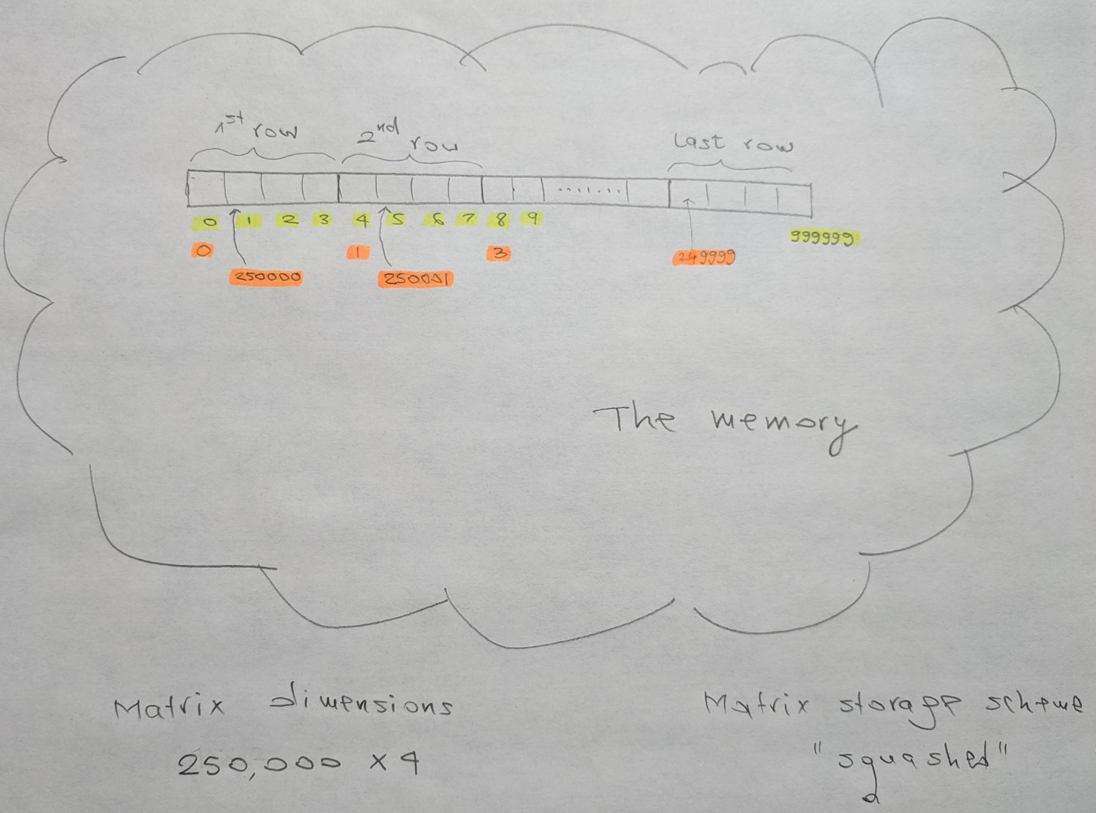
Matrix, stored in squashed format
2

Slide 53
Results, release build: 6 to 7 times faster if accessed w/ locality
TRUMAN Release> ./matrixRep1D.exe
Pass 1 for row-wise, pass 2 for column-wise sum.
TRUMAN Release> ./matrixRep1D.exe 1
The sum of the elements is: 2772.088785
Time spent in nanoseconds: 3
TRUMAN Release> ./matrixRep1D.exe 2
The sum of the elements is: 2772.088785
Time spent in nanoseconds: 23
OS Name Microsoft Windows 10 Enterprise 2016 LTSB
System Type x64-based PC
Processor Intel(R) Core(TM) i7-6800K CPU @ 3.40GHz, 3401 Mhz, 6 Core(s), 12 Logical Processor(s)
Installed Physical Memory (RAM) 32.0 GB
Compiler Visual Studio 2015 (Enterprise)

Slide 54
The 2D approach, revisited: locality vs. non-locality
#include <chrono> // need this for cross-platform timers in C++
#include <cstdio>
#include <cstdlib>
struct Matrix2D {
/// 2D matrix stored row-wise in a one dimensional array
unsigned int height; /// number of rows in matrix
unsigned int width; /// number of columns in matrix
double **pRows;
};
int main(int argc, char *argv[]) {
if (argc != 2) {
std::printf("Pass 1 for row-wise, pass 2 for column-wise sum.\n");
return 1;
}
int option = std::atoi(argv[1]);
struct Matrix2D mat2D;
mat2D.height = 2000; // perhaps you set this based on user input
mat2D.width = 2000; // perhaps you set this based on user input
mat2D.pRows = new double*[mat2D.height];
unsigned int i;
for (i = 0; i < mat2D.height; i++)
mat2D.pRows[i] = new double[mat2D.width];
// Get meaningful values in this matrix
unsigned int j;
for (i = 0; i < mat2D.height; i++)
for (j = 0; j < mat2D.width; j++)
mat2D.pRows[i][j] = 1. / (i + j + 1.);
// Compute sum of elements
double sum = 0;
auto start = std::chrono::high_resolution_clock::now(); // Get a timestamp
if (option == 1) {
for (i = 0; i < mat2D.height; i++)
for (j = 0; j < mat2D.width; j++)
sum += mat2D.pRows[i][j];
} else if (option == 2) {
for (j = 0; j < mat2D.width; j++)
for (i = 0; i < mat2D.height; i++)
sum += mat2D.pRows[i][j];
} else {
std::printf("Bad input option.\n");
return 1;
}
auto end = std::chrono::high_resolution_clock::now(); // Get a timestamp
auto elapsed = end – start; // Get difference between timestamps
std::printf("The sum of the elements is: %f\n", sum);
std::printf("Time spent in nanoseconds: %d\n",
std::chrono::duration_cast<std::chrono::nanoseconds>(elapsed).count()
);
// Don't need data anymore, free mem; note that delete is needed twice
for (i = 0; i < mat2D.height; i++)
delete[] mat2D.pRows[i];
delete[] mat2D.pRows;
return 0;
}

Slide 55
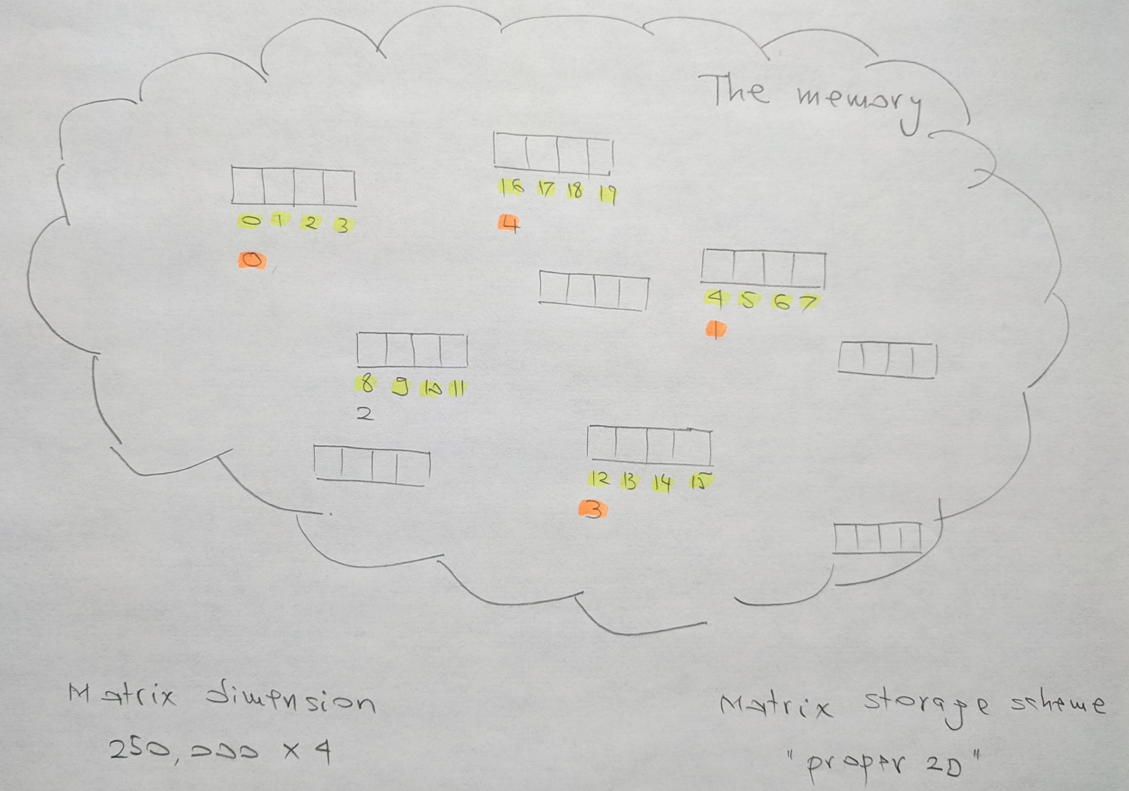
Matrix, stored in proper, 2D format

Slide 56
Results, release build: $≈$ 5 times faster if accessed w/ locality
TRUMAN Release> ./matrixRep2D.exe
Pass 1 for row-wise, pass 2 for column-wise sum.
TRUMAN Release> ./matrixRep2D.exe 1
The sum of the elements is: 2772.088785
Time spent in nanoseconds: 4
TRUMAN Release> ./matrixRep2D.exe 2
The sum of the elements is: 2772.088785
Time spent in nanoseconds: 20
OS Name Microsoft Windows 10 Enterprise 2016 LTSB
System Type x64-based PC
Processor Intel(R) Core(TM) i7-6800K CPU @ 3.40GHz, 3401 Mhz, 6 Core(s), 12 Logical Processor(s)
Installed Physical Memory (RAM) 32.0 GB
Compiler Visual Studio 2015 (Enterprise)

Slide 57
The two scenarios, side by side: squashed and proper 2D
TRUMAN Release> ./matrixRep1D.exe
Pass 1 for row-wise, pass 2 for column-wise sum.
TRUMAN Release> ./matrixRep1D.exe 1
The sum of the elements is: 2772.088785
Time spent in nanoseconds: 3
TRUMAN Release> ./matrixRep1D.exe 2
The sum of the elements is: 2772.088785
Time spent in nanoseconds: 23
TRUMAN Release> ./matrixRep2D.exe
Pass 1 for row-wise, pass 2 for column-wise sum.
TRUMAN Release> ./matrixRep2D.exe 1
The sum of the elements is: 2772.088785
Time spent in nanoseconds: 4
TRUMAN Release> ./matrixRep2D.exe 2
The sum of the elements is: 2772.088785
Time spent in nanoseconds: 20
OS Name Microsoft Windows 10 Enterprise 2016 LTSB
System Type x64-based PC
Processor Intel(R) Core(TM) i7-6800K CPU @ 3.40GHz, 3401 Mhz, 6 Core(s), 12 Logical Processor(s)
Installed Physical Memory (RAM) 32.0 GB
Compiler Visual Studio 2015 (Enterprise)

Slide 58
Final Exam type question: Qualitative Estimates of Locality
Being able to look at code and get a qualitative sense of its locality is a key skill for a professional programmer
Question: Below, do we have good locality with respect to array a?
int sum_array_rows(int** a)
{
int i, j, sum = 0;
for (i = 0; i < M; i++)
for (j = 0; j < N; j++)
sum += a[i][j];
return sum;
}
[Bryant and O‘Hallaron: Computer Systems - A Programmer's Perspective 3rd edition] →

Slide 59
Final Exam type question: Qualitative Estimates of Locality
Question: Does this function have good locality with respect to array a?
int sum_array_cols(int** a)
{
int i, j, sum = 0;
for (j = 0; j < N; j++)
for (i = 0; i < M; i++)
sum += a[i][j];
return sum;
}
[Bryant and O‘Hallaron: Computer Systems - A Programmer's Perspective 3rd edition] →

Slide 60
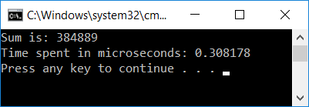
Taking it to the next level: 3D Matrices – good locality
OS Name Microsoft Windows 10 Enterprise 2016 LTSB
System Type x64-based PC
Processor Intel(R) Core(TM) i7-6800K CPU @ 3.40GHz, 3401 Mhz, 6 Core(s), 12 Logical Processor(s)
Installed Physical Memory (RAM) 32.0 GB
Compiler Visual Studio 2015 (Enterprise)
#include <iostream>
#include <chrono> // need this for timing
int main() {
const int M = 700;
double*** bPPP = new double**[M]; // use this to store 3d matrix
for (int i = 0; i < M; i++) {
bPPP[i] = new double*[M];
for (int j = 0; j < M; j++) {
bPPP[i][j] = new double[M];
for (int k = 0; k < M; k++)
bPPP[i][j][k] = 1. / (i + j + k + 1.); // storing some smallish number
}
}
double sum = 0.;
auto start = std::chrono::high_resolution_clock::now();
// sum up all entries in 3D array
for (int i = 0; i < M; i++)
for (int j = 0; j < M; j++)
for (int k = 0; k < M; k++)
sum += bPPP[i][j][k];
auto end = std::chrono::high_resolution_clock::now();
auto elapsed = end – start;
auto as_micro = std::chrono::duration_cast<std::chrono::duration<double, std::micro>>(elapsed);
std::cout << "Sum is: " << sum << std::endl;
std::cout << "Time spent in microseconds: " << as_micro.count() << std::endl;
return 0;
}
NOTE: We didn't delete[] our memory in this example, but you should always do it in your code.

Slide 61
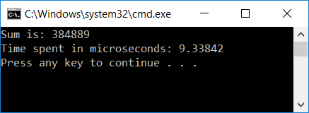
Taking it to the next level: 3D Matrices – bad locality
OS Name Microsoft Windows 10 Enterprise 2016 LTSB
System Type x64-based PC
Processor Intel(R) Core(TM) i7-6800K CPU @ 3.40GHz, 3401 Mhz, 6 Core(s), 12 Logical Processor(s)
Installed Physical Memory (RAM) 32.0 GB
Compiler Visual Studio 2015 (Enterprise)
#include <iostream>
#include <chrono> // need this for timing
int main() {
const int M = 700;
double*** bPPP = new double**[M]; // use this to store 3d matrix
for (int i = 0; i < M; i++) {
bPPP[i] = new double*[M];
for (int j = 0; j < M; j++) {
bPPP[i][j] = new double[M];
for (int k = 0; k < M; k++)
bPPP[i][j][k] = 1. / (i + j + k + 1.); // storing some smallish number
}
}
double sum = 0.;
auto start = std::chrono::high_resolution_clock::now();
// sum up all entries in 3D array
for (int k = 0; k < M; k++)
for (int j = 0; j < M; j++)
for (int i = 0; i < M; i++)
sum += bPPP[i][j][k];
auto end = std::chrono::high_resolution_clock::now();
auto elapsed = end – start;
auto as_micro = std::chrono::duration_cast<std::chrono::duration<double, std::micro>>(elapsed);
std::cout << "Sum is: " << sum << std::endl;
std::cout << "Time spent in microseconds: " << as_micro.count() << std::endl;
return 0;
}
NOTE: We didn't delete[] our memory in this example, but you should always do it in your code.

Slide 62
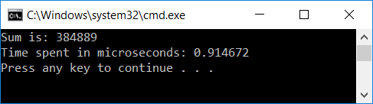
Running the code in Debug vs. Release mode: big difference?
OS Name Microsoft Windows 10 Enterprise 2016 LTSB
System Type x64-based PC
Processor Intel(R) Core(TM) i7-6800K CPU @ 3.40GHz, 3401 Mhz, 6 Core(s), 12 Logical Processor(s)
Installed Physical Memory (RAM) 32.0 GB
Compiler Visual Studio 2015 (Enterprise)
#include <iostream>
#include <chrono> // need this for timing
int main() {
const int M = 700;
double*** bPPP = new double**[M]; // use this to store 3d matrix
for (int i = 0; i < M; i++) {
bPPP[i] = new double*[M];
for (int j = 0; j < M; j++) {
bPPP[i][j] = new double[M];
for (int k = 0; k < M; k++)
bPPP[i][j][k] = 1. / (i + j + k + 1.); // storing some smallish number
}
}
double sum = 0.;
auto start = std::chrono::high_resolution_clock::now();
// sum up all entries in 3D array
for (int i = 0; i < M; i++)
for (int j = 0; j < M; j++)
for (int k = 0; k < M; k++)
sum += bPPP[i][j][k];
auto end = std::chrono::high_resolution_clock::now();
auto elapsed = end – start;
auto as_micro = std::chrono::duration_cast<std::chrono::duration<double, std::micro>>(elapsed);
std::cout << "Sum is: " << sum << std::endl;
std::cout << "Time spent in microseconds: " << as_micro.count() << std::endl;
return 0;
}
“Debug” mode
“Release” mode

Slide 63
Three observations related to our 2D and 3D examples
Observation 1: Final value for sum - stays the same (at least as far as we can tell)
We’ll talk more about this when we do parallel computing w/ CUDA and then OpenMP
Observation 2: Difference between Debug vs Release builds
3X to 4X speedup normal to see when going from debug to release (see also results on next slide)
Observation 3: Amount of time to get the result quite different
Release mode build: the undesirable solution for 3D matrix is 30 times slower
This is the case you see in practice – you build in release

Slide 64
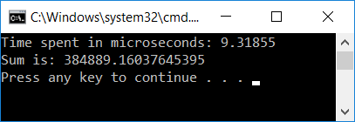
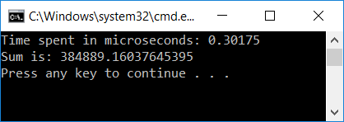
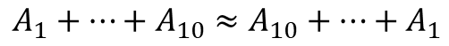
Observations on “Observation 1”
The fact that the results are the same is remarkable
Why remarkable?
Finite precision arithmetic: addition loses its commutative and associative attributes
Because of finite precision
$$A_{1}+…+A_{10}≈A_{10}+…+A_{1}$$
$${((…((A}_{1}+A_{2})+A_{3})+A_{4})+…+A_{10})≈{(A}_{1}+{(A}_{2}+(…+(A_{9}+A_{10}))…))$$
Because of finite precision

Slide 65
Observations on “Observation 3” (most important)
First time in 759 discussing how to improve performance
This type of gain; i.e., 30X speed up, not encountered every day…
Q: What mechanism comes into play to yield a 30X speed gain?
A: The cache
L1 cache: 4 cycles
System memory access: 120 cycles

Slide 66
Indirection and how it’s hurting… An example. [one slide side trip]
Indirection: given an index i, you don’t need a[i]
Rather, you need a[indir[i]] (this is one level of indirection; can go higher yet…)
What’s hurting here?
First, when stride is large, you index into an array indir of non-negative integers but keep missing
No locality…
Second, you will subsequently jump in the array a all over the place
Very likely you’ll just keep missing
Unfortunately, indirection in computing very common
void loop(int* a, unsigned int* indir, int N, int stride)
{
int sum = 0;
for (int i = 0; i < N; i+=stride)
sum += a[indir[i]];
}

Slide 67
The Lesson Learned
Fact: Wide gap between using data and moving data
Using data: you do sin of that data, log, pow, add, subtract, etc. (processing the data)
Moving data: getting your data from the system memory (64 GB/128/etc. GB that you have on your system)
Fact: The cache used to close the big speed gap
Trait of well-written programs: they manage to leverage data/instruction locality
Locality is what allows caches to come into play
Locality necessary, but not sufficient (more later, “false sharing”)

Slide 68
We’ve seen that caches can make a difference in speed of execution
Let’s see how they work, which will explain why they help

Slide 69
[Back to caches: The inner workings of caches] General Cache Concepts
Everything handled in hardware. Invisible to programmer
Smaller, faster, more expensive
memory can store a subset of
the main memory blocks
The Cache
8
4
9
14
10
3
Data copied in block-sized transfer units. Each block (such as block 10, for instance) typically holds 64 bytes of data (called cache line).
4
10
0
1
2
3
4
4
5
6
7
8
9
10
The Main Memory
10
11
Main Memory: Larger, slower, cheaper memory
(shown here as partitioned into “blocks” that are
mapped into cache lines)
12
13
14
15
[Bryant and O‘Hallaron: Computer Systems - A Programmer's Perspective 3rd edition] →

Slide 70
Cache Line (aka Cache Block)
When data is brought in cache because a piece of data is needed, the MMU brings more than just the needed piece of data
Why bring more data than what absolutely necessary?
Because penalty is not high for bringing more: wide buses, little extra cost in bringing more data than exactly what needed
Corollary: you will reduce the number of trips to main memory if you use multiple times data from a cache line
“cache line”
Many systems have cache line of 64 Bytes (8 doubles OR 16 floats OR 16 ints OR 64 chars, etc.)
Cache line size is the same for L1, L2 and L3 caches

Slide 71
General Cache Concepts: Hit
Delivery to registers…
Request: 14
Data in block b is needed
Block b is in cache:
Hit!
Cache
8
9
14
3
14
Memory
0
1
2
3
4
5
6
7
8
9
10
11
Hit Rate: on average, how many out of 100 mem requests hit the cache?
12
13
14
15
[Bryant and O‘Hallaron: Computer Systems - A Programmer's Perspective 3rd edition] →

Slide 72
General Cache Concepts: Miss
Delivery to registers…
Request: 12
Data in block b is needed
Block b is not in cache:
Miss!
Cache
8
9
14
3
12
Block b is fetched from
memory
12
Request: 12
Memory
0
1
2
3
Block b is stored in cache
Placement policy: determines where Block b goes
Replacement policy: determines which block gets evicted (victim)
4
5
6
7
8
9
10
11
12
12
13
14
15
[Bryant and O‘Hallaron: Computer Systems - A Programmer's Perspective 3rd edition] →

Slide 73
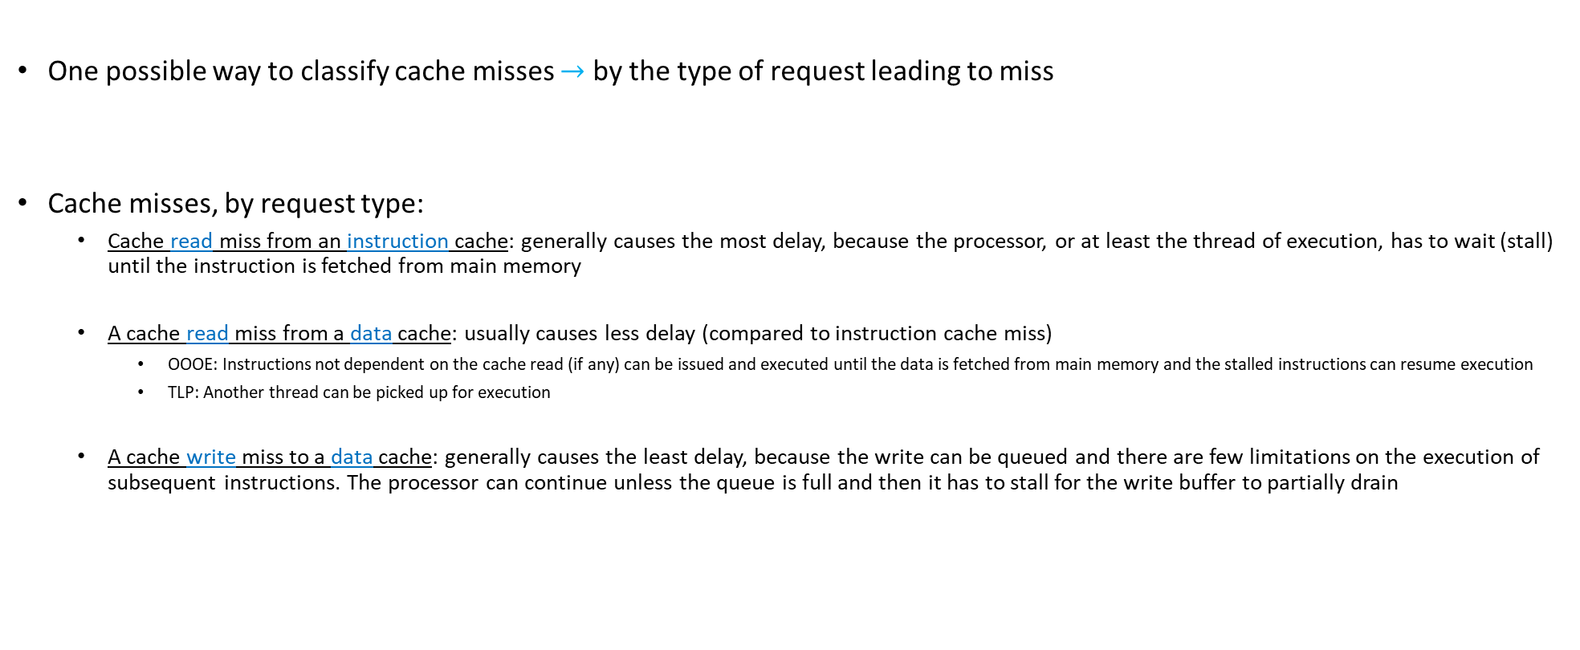
Cache Miss Classification, by Request Type
One possible way to classify cache misses $→$ by the type of request leading to miss
Cache misses, by request type:
Cache read miss from an instruction cache: generally causes the most delay, because the processor, or at least the thread of execution, has to wait (stall) until the instruction is fetched from main memory
A cache read miss from a data cache: usually causes less delay (compared to instruction cache miss)
OOOE: Instructions not dependent on the cache read (if any) can be issued and executed until the data is fetched from main memory and the stalled instructions can resume execution
TLP: Another thread can be picked up for execution
A cache write miss to a data cache: generally causes the least delay, because the write can be queued and there are few limitations on the execution of subsequent instructions. The processor can continue unless the queue is full and then it has to stall for the write buffer to partially drain

Slide 74
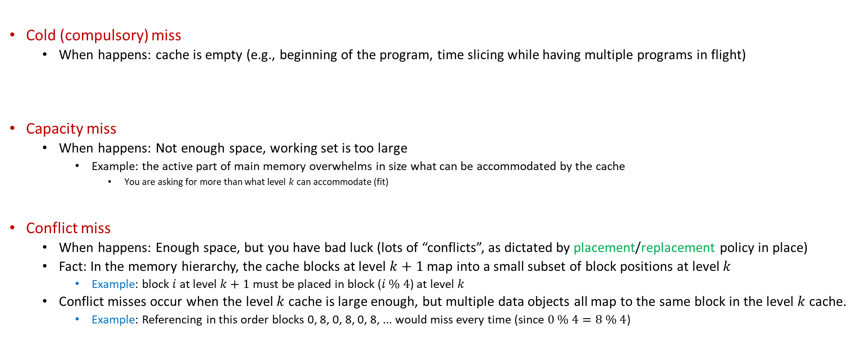
Reasons for Cache Misses
Cold (compulsory) miss
When happens: cache is empty (e.g., beginning of the program, time slicing while having multiple programs in flight)
Capacity miss
When happens: Not enough space, working set is too large
Example: the active part of main memory overwhelms in size what can be accommodated by the cache
You are asking for more than what level $k$ can accommodate (fit)
Conflict miss
When happens: Enough space, but you have bad luck (lots of “conflicts”, as dictated by placement/replacement policy in place)
Fact: In the memory hierarchy, the cache blocks at level $k+1$ map into a small subset of block positions at level $k$
Example: block $i$ at level $k+1$ must be placed in block ($i \% 4$) at level $k$
Conflict misses occur when the level $k$ cache is large enough, but multiple data objects all map to the same block in the level $k$ cache.
Example: Referencing in this order blocks 0, 8, 0, 8, 0, 8, ... would miss every time (since $0 \% 4=8 \% 4$)

Slide 75
Placement & Replacement Policies
The cache is small, while the memory that you try to cache in this cache is large
The cache: prime real estate – when somebody comes in, somebody else has to be evicted
Caching: like bringing visitors from a large city to live in one apartment building next to some prime attraction
“prime attraction”: the registers and the ALU/CU
placement policy: deciding at which “floor of the building” to host the new visitors (the new cache line)
If there are 2 or 4 or 8, etc. apartments (cache lines) at each floor level, which apartment do you choose?
“replacement policy” – if you have Option A and Option B, which one should you choose: A or B?
You’ll kick out tenants from apartment A, or tenants from apartment B?

Slide 76
Placement & Replacement Policies [continued]
Policies that are common:
“When you bring a line of cache…”
You are free to place wherever (fully associative cache): Only 1 floor in the building (ranch-style apartment building), but lots of apartments
Based on the address of the request you can put it in one of the 4 floors (many floors, and four apartments at each floor level)
You can have, for instance, 2 apartments, or 8 apartments, or k places (for k-way associative cache)
You can only put it in one place (direct mapped cache): skyscraper, but with one apartment per floor
Note: you always have to place; sometimes you have to replace, too

Slide 77
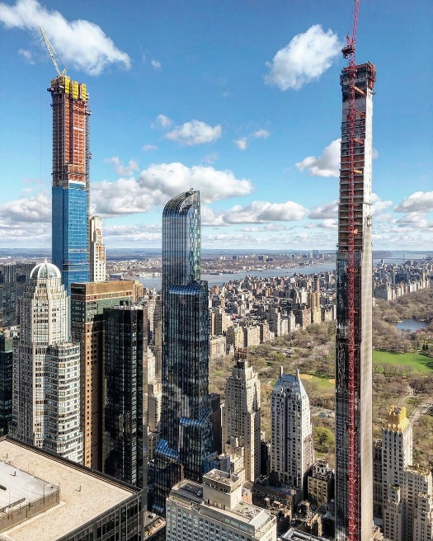


Placement & Replacement Policies [continued]
Direct mapping: cache is skinny skyscraper, with one apartment per floor
Recall that apartment is large enough to accommodate 64 folks (Bytes)
Associative, K-way: a certain number of floors, each with K apartments
Fully associative cache: apartment level with ground level only

Slide 78
Placement & Replacement Policies: further discussion
Fully associative (the ranch)
Pros: you have full control which old cache line you want to kick out (lots of freedom for replacement policy)
Cons:
Higher overhead to find what you’re looking for (data can be anywhere in cache)
Higher overhead to decide whom to evict (the “victim”)
Direct mapped (the tall skinny skyscraper)
Pros: very fast to find if in cache or not
Cons: sometimes, you’ll have to evict a line cache that sees a lot of use (no freedom at all in the placement policy)
K-way associative (Hilton Garden Inn)
Decent compromise:
It yields a reasonably decent replacement policy – you have K options to choose from
At the same time, you don’t have to search too many apartments at a floor level
NOTE: Intel and AMD chips - 2, 4, 8, 16-way associative
Depends on cache level and which chip model

Slide 79
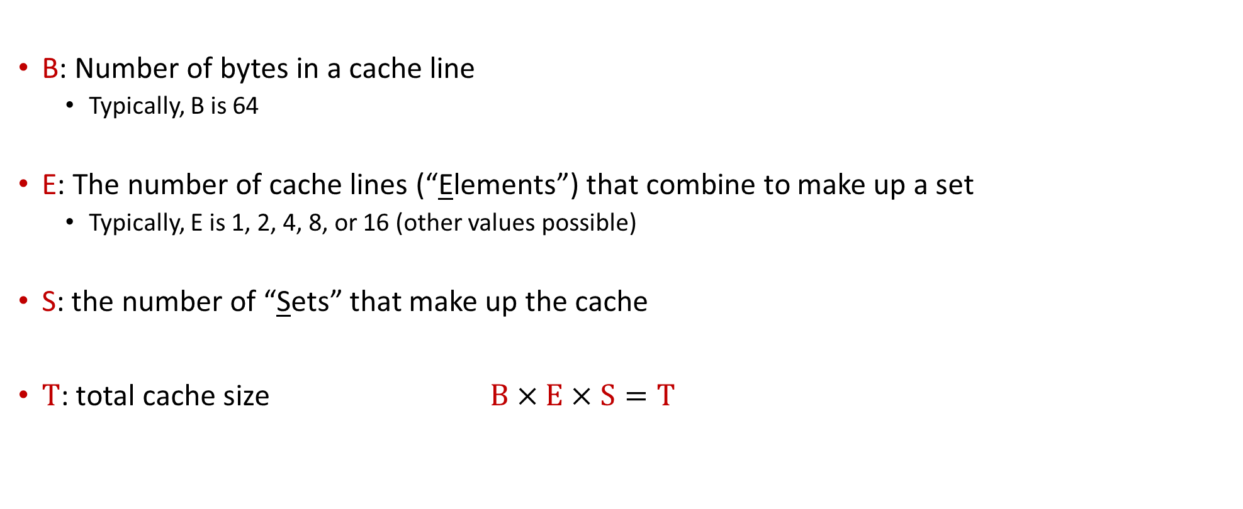
[New Topic:] General Cache Organization [Symbols Used and Their Meaning]
B: Number of bytes in a cache line
Typically, B is 64
E: The number of cache lines (“Elements”) that combine to make up a set
Typically, E is 1, 2, 4, 8, or 16 (other values possible)
S: the number of “Sets” that make up the cache
$T$: total cache size $B×E×S=T$

